Slide 1
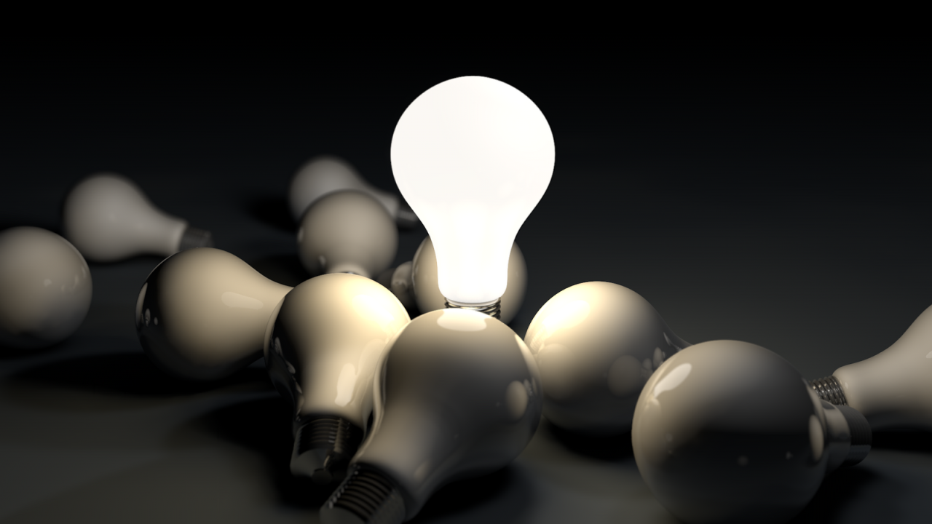
Jesus the Teacher: The True Light
John 1:9; 8:12
“The true light coming into the world”

Slide 2

Jesus the Teacher: The True Light
Introduction: It’s the Real Thing
John 1:9
“That was the true light…”
6:32 - True bread
15:1 – True vine

Slide 3
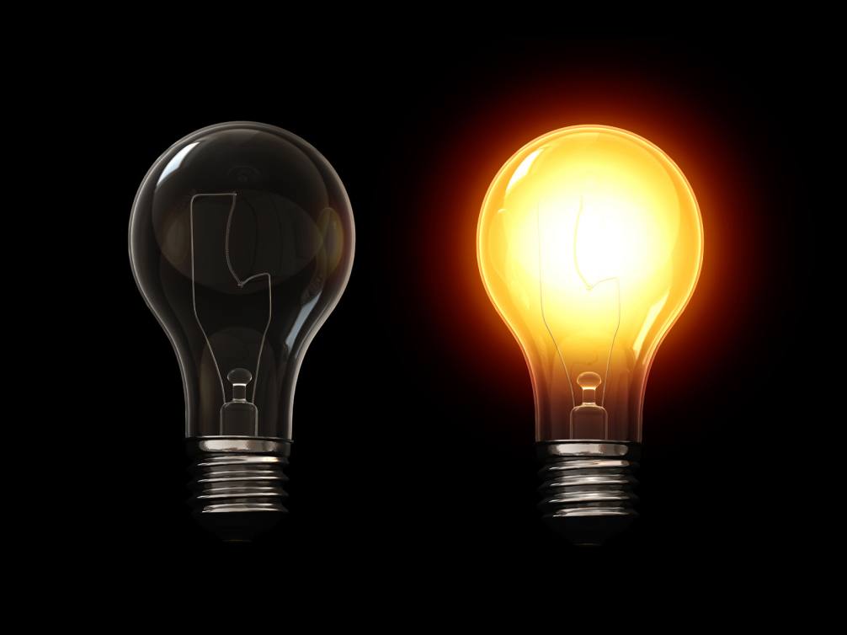
Real Light
- In contrast to counterfeits
John 1:1-9
The Greeks: philosophy
The Romans: power
The Jews: religion

Slide 4
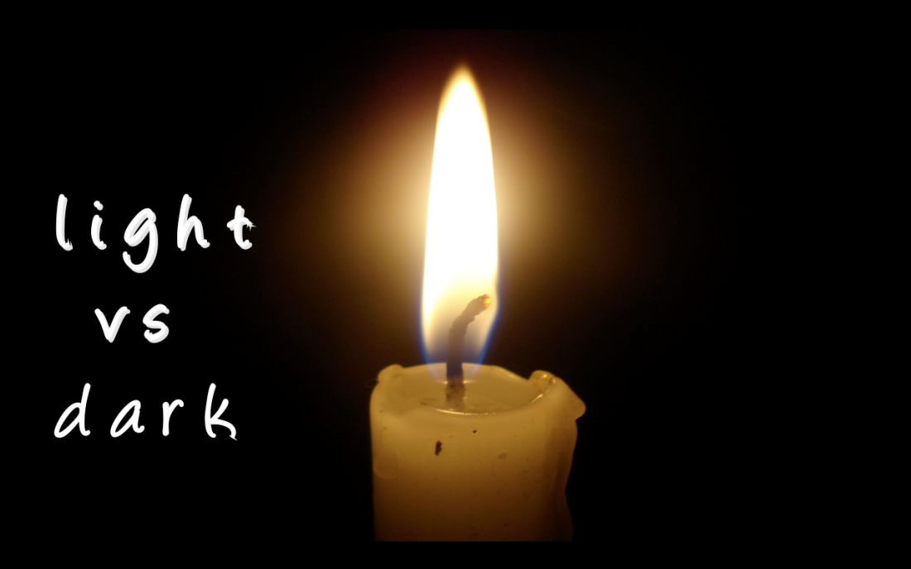
Real Light - In contrast to counterfeits
Real Light – In context of darkness
John 8:12
Where?
- Temple
8:2; 8:20
When?
- Feast of Tabernacles
7:14; 7:37-40

Slide 5
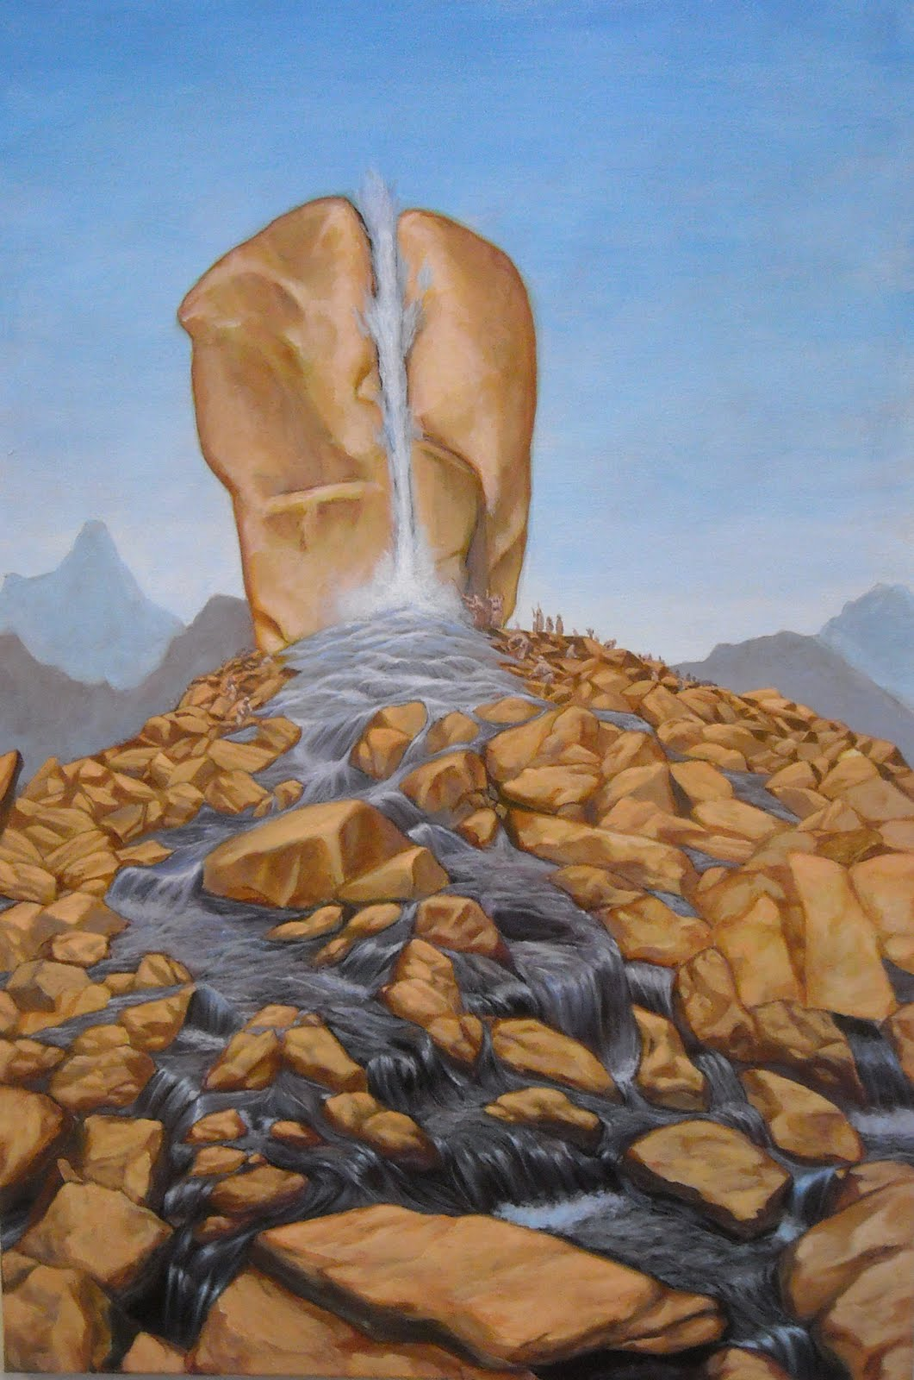
2. Real Light – In context of darkness
a) Drink and Light
Feast of Tabernacles
Thirsty?
Drink!
7:37

Slide 6
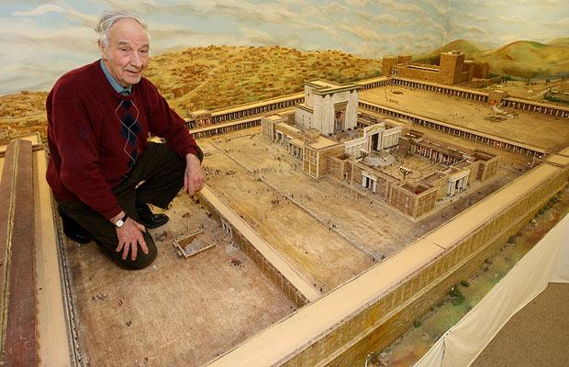
The Temple

Slide 7
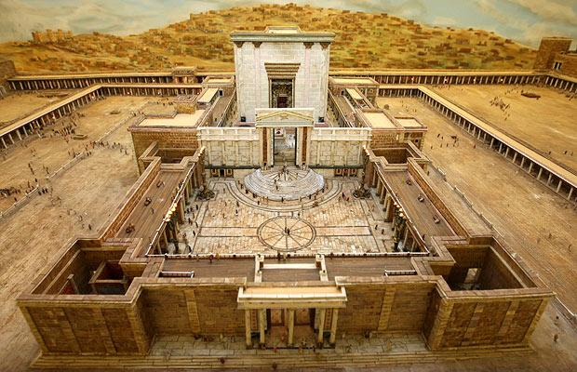

The Temple

Slide 8
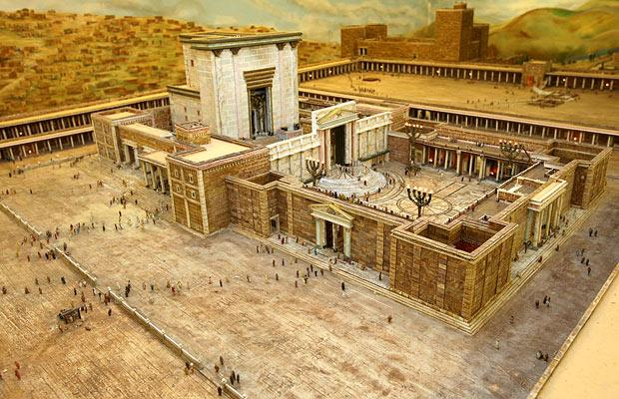
The Temple

Slide 9
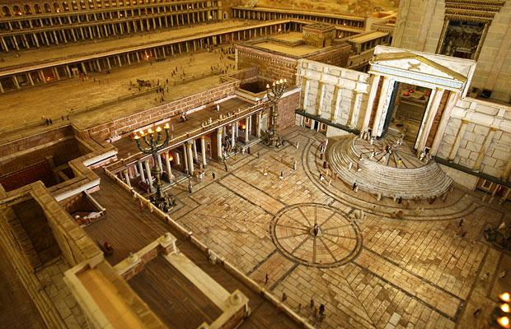
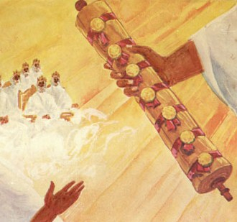
Now is more Settled than it Seems
It’s all in the Scroll
Dan 6:12
History is His Story

Slide 10
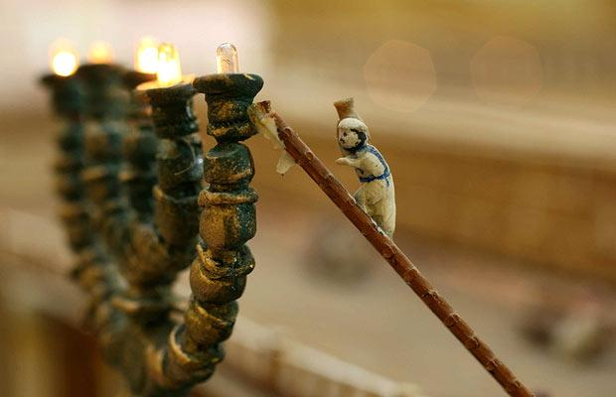
Now is more Settled than it Seems
It’s all in the Scroll
“God from all eternity did by the most wise and holy counsel of his own will freely and unchangeably ordain whatever comes to pass, yet so that neither is God the author of sin, nor is violence offered to the will of the creatures, nor is the liberty of second causes taken away, but rather established.”

Slide 11
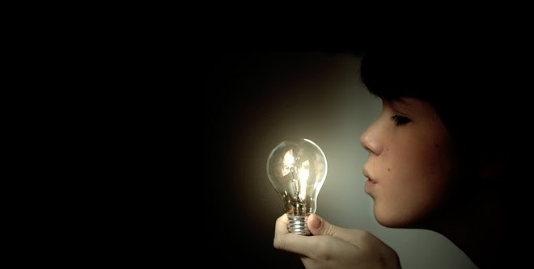
2. Real Light – In context of darkness
Drink and Light - 8:12
Dimming the Light
Egypt – Ezek 32:2-8
Babylon – Is 13:1-13
Israel – Mk 13:2-26

Slide 12

Drink and Light
Dimming the Light
Darkness and Light
Judaism: false religion
Greeks: false philosophy
Romans: false power
Paganism: false mysticism
Colossians 2:8

